Slide 1
Chapter 10 – Logistic Regression
Data Mining for Business Analytics in R
Shmueli, Bruce, Yahav, Patel & Lichtendahl
© Galit Shmueli and Peter Bruce 2017

Slide 2
Logistic Regression
Extends idea of linear regression to situation where outcome variable is categorical
Widely used, particularly where a structured model is useful to explain (=profiling) or to predict
We focus on binary classification
i.e. Y=0 or Y=1
© Galit Shmueli and Peter Bruce 2017
Notes:
‹#›

Slide 3
The Logit
Goal: Find a function of the predictor variables that relates them to a 0/1 outcome
Instead of Y as outcome variable (like in linear regression), we use a function of Y called the logit
Logit can be modeled as a linear function of the predictors
The logit can be mapped back to a probability, which, in turn, can be mapped to a class
© Galit Shmueli and Peter Bruce 2017
Notes:
‹#›

Slide 4
Step 1: Logistic Response Function
p = probability of belonging to class 1
Need to relate p to predictors with a function that guarantees 0 ≤ p ≤ 1
Standard linear function (as shown below) does not:
q = number of predictors
© Galit Shmueli and Peter Bruce 2017
Notes:
‹#›

Slide 5

The Fix: use logistic response function
Equation 10.2 in textbook
© Galit Shmueli and Peter Bruce 2017
Notes:
‹#›

Slide 6
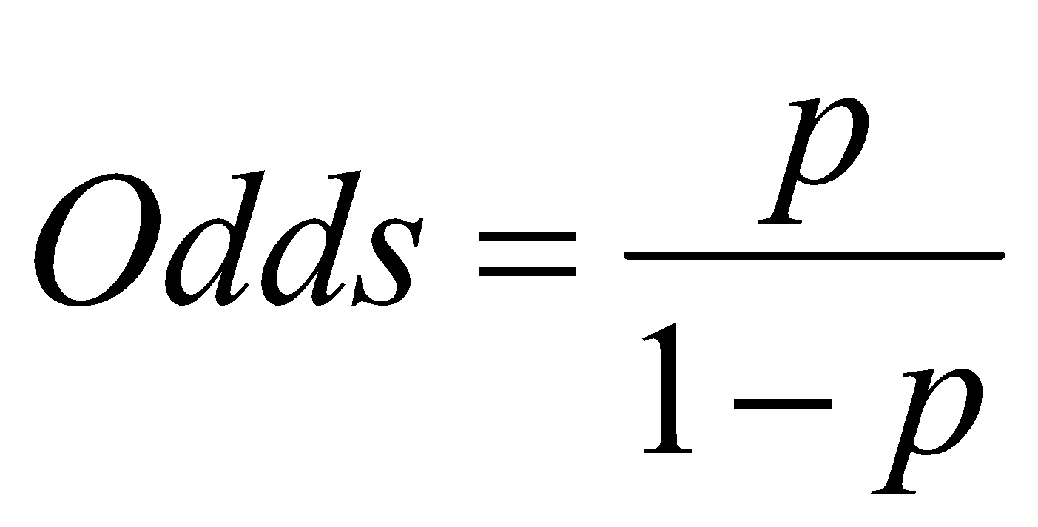
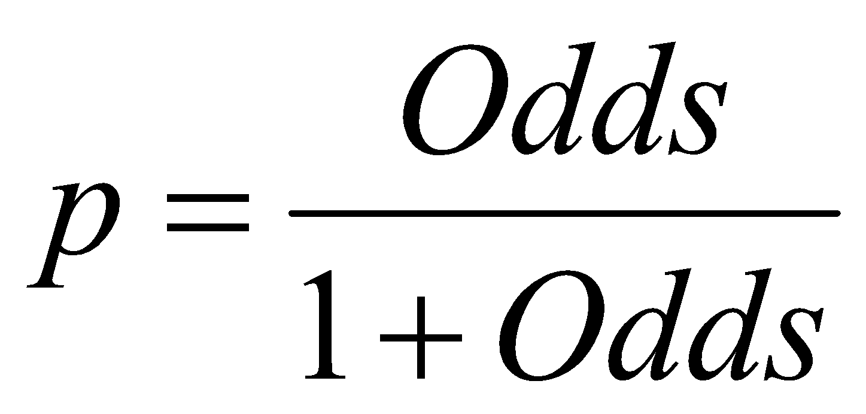
Step 2: The Odds
The odds of an event are defined as:
eq. 10.3
p = probability of event
Or, given the odds of an event, the probability of the event can be computed by:
eq. 10.4
© Galit Shmueli and Peter Bruce 2017

Slide 7
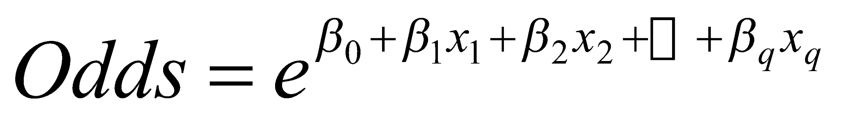
We can also relate the Odds to the predictors:
eq. 10.5
To get this result, substitute 10.2 into 10.4
© Galit Shmueli and Peter Bruce 2017
Notes:
‹#›

Slide 8
Step 3: Take log on both sides
This gives us the logit:
log(Odds) = logit (eq. 10.6)
© Galit Shmueli and Peter Bruce 2017
Notes:
‹#›

Slide 9
Logit, cont.
So, the logit is a linear function of predictors x₁, x₂, …
Takes values from -infinity to +infinity
Review the relationship between logit, odds and probability
© Galit Shmueli and Peter Bruce 2017
Notes:
‹#›

Slide 10
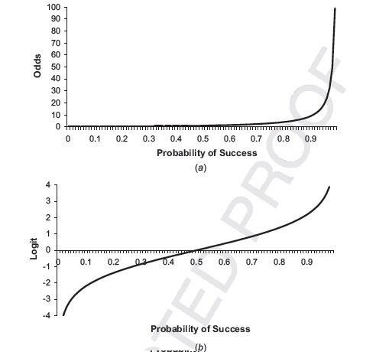
Odds (a) and Logit (b) as function of P
© Galit Shmueli and Peter Bruce 2017

Slide 11
Example
© Galit Shmueli and Peter Bruce 2017
Notes:
‹#›

Slide 12
Personal Loan Offer (UniversalBank.csv)
Outcome variable: accept bank loan (0/1)
Predictors: Demographic info, and info about their bank relationship
© Galit Shmueli and Peter Bruce 2017
Notes:
‹#›

Slide 13
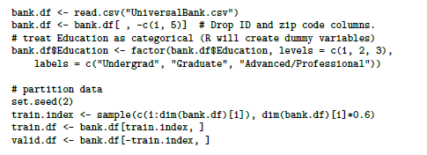
Data Prep
training partition of 60%
© Galit Shmueli and Peter Bruce 2017

Slide 14

Single Predictor Model
Modeling loan acceptance on income (x)
Fitted coefficients (more later): b₀ = -6.3525, b₁ = -0.0392
© Galit Shmueli and Peter Bruce 2017
Notes:
‹#›

Slide 15
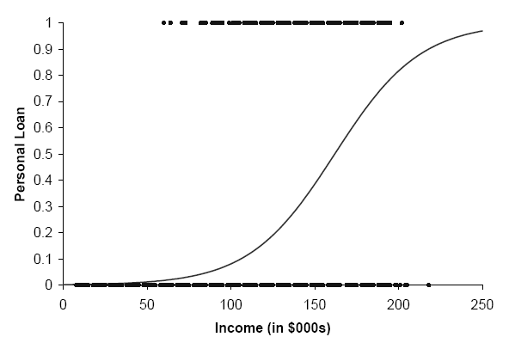
Seeing the Relationship
© Galit Shmueli and Peter Bruce 2017

Slide 16
Last step - classify
Model produces an estimated probability of being a “1”
Convert to a classification by establishing cutoff level
If estimated prob. > cutoff, classify as “1”
© Galit Shmueli and Peter Bruce 2017
Notes:
‹#›

Slide 17
Ways to Determine Cutoff
0.50 is popular initial choice
Additional considerations (see Chapter 5)
Maximize classification accuracy
Maximize sensitivity (subject to min. level of specificity)
Minimize false positives (subject to max. false negative rate)
Minimize expected cost of misclassification (need to specify costs)
© Galit Shmueli and Peter Bruce 2017
Notes:
‹#›

Slide 18
Example, cont.
Estimates of β’s are derived through an iterative process called maximum likelihood estimation
Let’s include all 12 predictors in the model now
In R use function glm (for general linear model) and family = “binomial”
© Galit Shmueli and Peter Bruce 2017
Notes:
‹#›

Slide 19
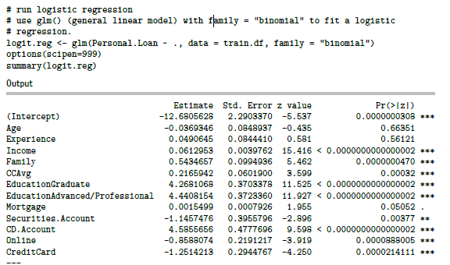
Fitting the Model
coefficients for logit
© Galit Shmueli and Peter Bruce 2017

Slide 20
Converting to Probability
© Galit Shmueli and Peter Bruce 2017
Notes:
‹#›

Slide 21
Function predict does the conversion from logit to probabilities
# use predict() with type = "response" to compute
# predicted probabilities.
logit.reg.pred <- predict(logit.reg, valid.df[, -
8], type = "response")
# first 5 actual and predicted records
data.frame(actual = valid.df$Personal.Loan[1:5],
predicted = logit.reg.pred[1:5])
Output
> data.frame(actual = valid.df$Personal.Loan[1:5],
+ predicted = logit.reg.pred[1:5])
actual predicted
2 0 0.00002707663
6 0 0.00326343313
9 0 0.03966293189
10 1 0.98846040544
11 0 0.59933974797
© Galit Shmueli and Peter Bruce 2017

Slide 22
Interpreting Odds, Probability
For predictive classification, we typically use probability with a cutoff value
For explanatory purposes, odds have a useful interpretation:
If we increase x₁ by one unit, holding x₂, x₃ … x_{q} constant, then
b₁ is the factor by which the odds of belonging to class 1 increase
© Galit Shmueli and Peter Bruce 2017
Notes:
‹#›

Slide 23
Loan Example: Evaluating Classification Performance
Performance measures: Confusion matrix and % of misclassifications
More useful in this example: lift
© Galit Shmueli and Peter Bruce 2017
Notes:
‹#›

Slide 24
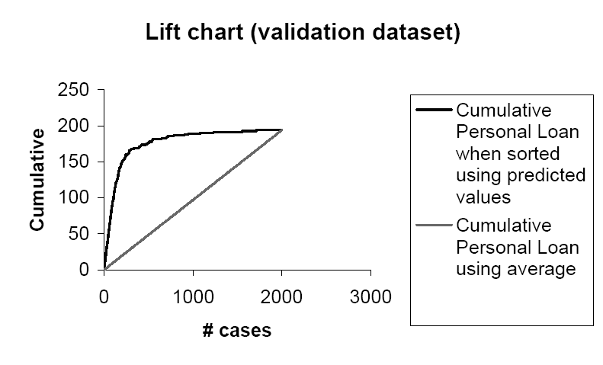
© Galit Shmueli and Peter Bruce 2017

Slide 25
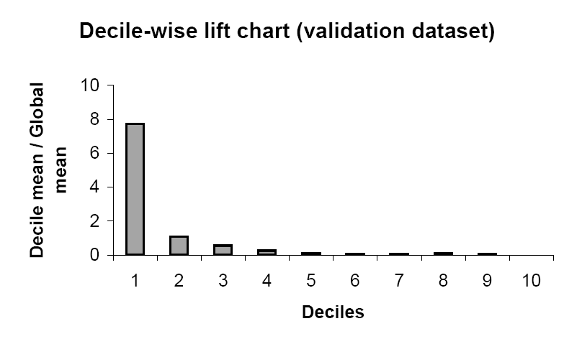
© Galit Shmueli and Peter Bruce 2017

Slide 26
Multicollinearity
Problem: As in linear regression, if one predictor is a linear combination of other predictor(s), model estimation will fail
Note that in such a case, we have at least one redundant predictor
Solution: Remove extreme redundancies (by dropping predictors via variable selection, or by data reduction methods such as PCA)
© Galit Shmueli and Peter Bruce 2017
Notes:
‹#›

Slide 27
Variable Selection
This is the same issue as in linear regression
The number of correlated predictors can grow when we create derived variables such as interaction terms (e.g. Income x Family), to capture more complex relationships
Problem: Overly complex models have the danger of overfitting
Solution: Reduce variables via automated selection of variable subsets (as with linear regression)
See Chapter 6
© Galit Shmueli and Peter Bruce 2017
Notes:
‹#›

Slide 28
P-values for Predictors
Test null hypothesis that coefficient = 0
Useful for review to determine whether to include variable in model
Important in profiling tasks, but less important in predictive classification
© Galit Shmueli and Peter Bruce 2017
Notes:
‹#›

Slide 29
Summary
Logistic regression is similar to linear regression, except that it is used with a categorical response
It can be used for explanatory tasks (=profiling) or predictive tasks (=classification)
The predictors are related to the response Y via a nonlinear function called the logit
As in linear regression, reducing predictors can be done via variable selection
Logistic regression can be generalized to more than two classes
© Galit Shmueli and Peter Bruce 2017
Notes:
‹#›

